Slide 1
Evaluating Proxy Caching Algorithms in Mobile Environments
Mallika Ghurye, Aditi Sharma, Sruthi Shyamsunder

Slide 2
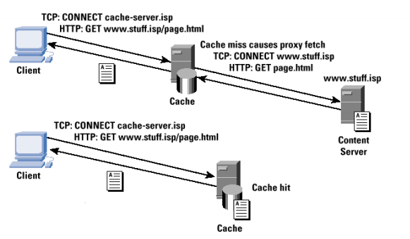
Basic Idea-Web Caching
As the content on the web grows,an
important technique to reduce
bandwidth consumption is web caching
Today many networks have hierarchies
of proxy caches which interact to reduce
the traffic on the internet
Advantages:
Reduces bandwidth needs and cost
Faster delivery of Web objects to the end user
Benefits the user,the service provider and the website owner
Reduces load on the website servers

Slide 3
Need for Mobile Caching
Web Caching Approach not applicable to mobile devices
Mobile Computing Challenges
  Limited caching capabilities on device (memory and power consumption constraints)
  Variable but lower bandwidth
  Loss of connectivity
Solutions
  Caching at a Proxy Server (lower latency)
  Effective Cache Replacement Algorithms (LRU, LFU, HLRU)
  Proactive Caching (Prefetching and collecting data in advance)
  Collaborative Caching

Slide 4

Project Overview
Video Request
Response
Cache Hit
INTERNET
Cache Miss
Android User 1
Query
Cache
Laptop
Video Request
Android User 2

Slide 5
Cache Replacement Algorithm
History Based Least Recently Used Algorithm
The ’hist’ parameter defines the time of the past reference to the object.
hist(x,h)={ ti if there are h-1 references between the times ti and tn;
0 otherwise
}
where t1, t2,....tn are time of request r1,r2,...rn
If there are many objects with hist=0, the LRU is used to purge objects from the cache. The HLRU will replace objects with the maximum hist value.
Some of the parameters that the HLRU hold are:
OldAccessTime (first time of access)
NewTimeAccess(last time access)
positionInFile(position of object in the file)
Maintain a linked list of all access times.

Slide 6
Implementation Details
Setting up Laptop as a proxy
  Setting will be similar to how things work in an enterprise
  Proxy servers are a central machine with an internet connection where other machines connect and use the Internet
  The proxy will share its data with other machine, in our case mobile nodes
  If the requested data is not found in the mobile’s browser, it places a request to the laptop which is set up as proxy

Slide 7
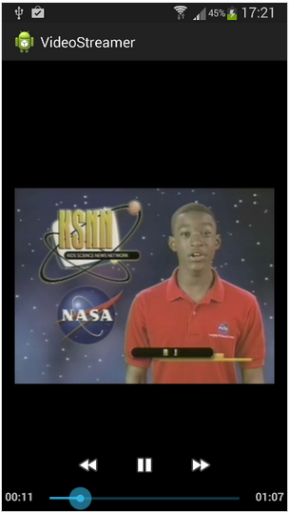
Android Video Streaming Application
Create a Video Streaming Application using Android Libraries
  Goal: Stream Video Files to visualize low latency due to caching
  Tools: Eclipse/Android Studio, Android libraries
  Process will consist of the following two steps
    Use the VideoView Class to play video files
    Video is streamed using the video address (URI)
  Alternatively the MediaPlayer Class and Activity Class could also be used to create the application.

Slide 8
Extended Implementation
Collaborative Caching Technique
We plan to implement a collaborative caching technique which is similar to a ‘tit-for-tat’ mechanism
A mobile node is entitled to access the cache information only if it first agree to share its own cache content with the proxy

